Slide 1
LinkML for schemas, vocabularies and entities
Data Integration: Prajal Bishwakarma and Tim Fliss

Slide 2
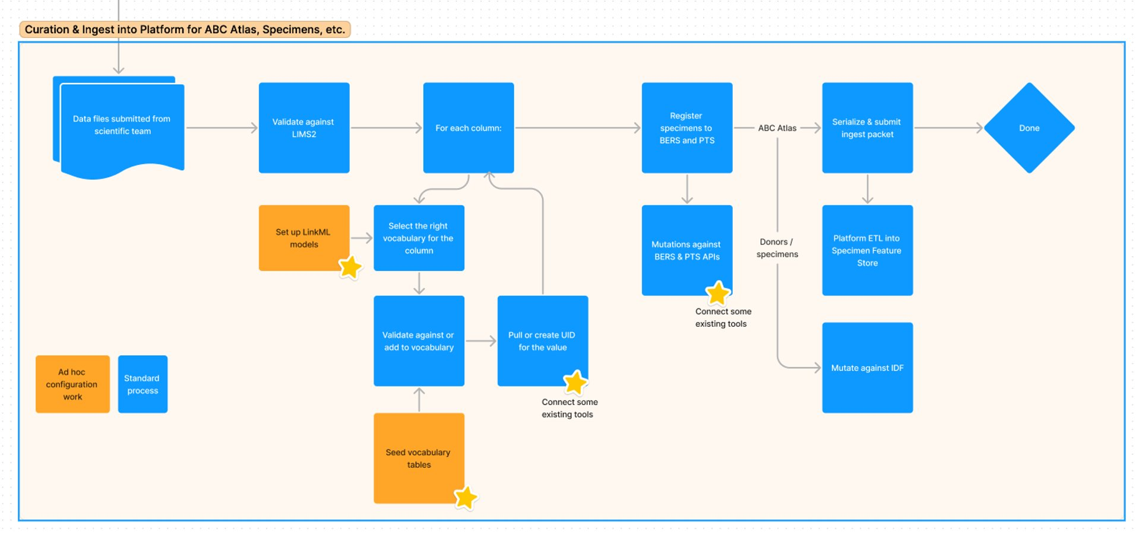
https://www.figma.com/file/faGZcFzpNdi12PXtErIdgI/Schematic-for-Working-Meeting%3A-ABC-Atlas-data-flow?type=whiteboard&node-id=305-423
Notes:
The Data Integration team at the Allen Institute has been working with the Knowledge Graph team to exchange information about our use of LinkML.
We wanted to see how the AtlasKB models could be used with the Data Integration ingest pipeline.​
​ This is a data flow diagram for how we previously used LinkML to define input data tables and vocabularies for the ABC Atlas.

Slide 3

Notes:
The first stage of ingest involves simply loading data into the system. The data integration pipeline is designed to have pluggable data sources, but primarily accepts CSV or Excel tables via file upload.
We also run the pipeline back-end with data files sourced from Amazon Web Services S3. The demo today will use a development system on a local machine.
A major check that we do is to confirm that the entries in the data columns match the allowed entries stored in our LIMS2 database.
Rather than query the LIMS or other remote databases directly for each entry, our ingest pipeline is designed as an efficient large-scale label-to-ID cache.
So the first step is to seed each needed vocabulary with the needed terms.
The pipeline is then configured with models representing the table columns and corresponding vocabularies.

Slide 4
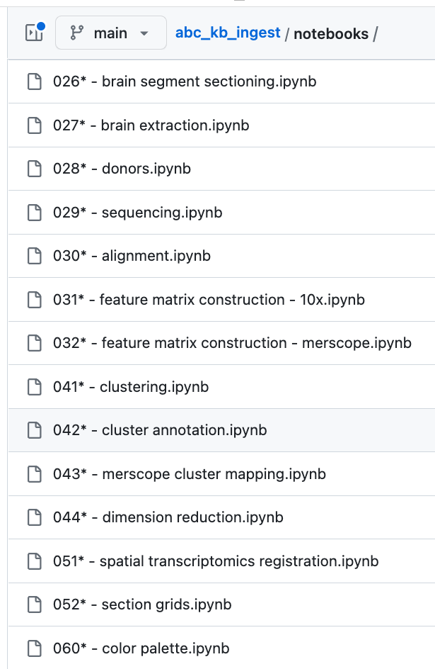
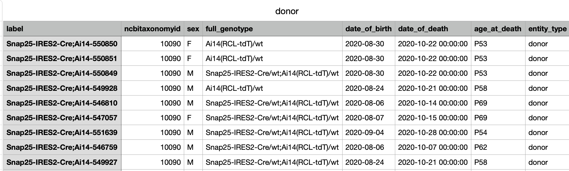
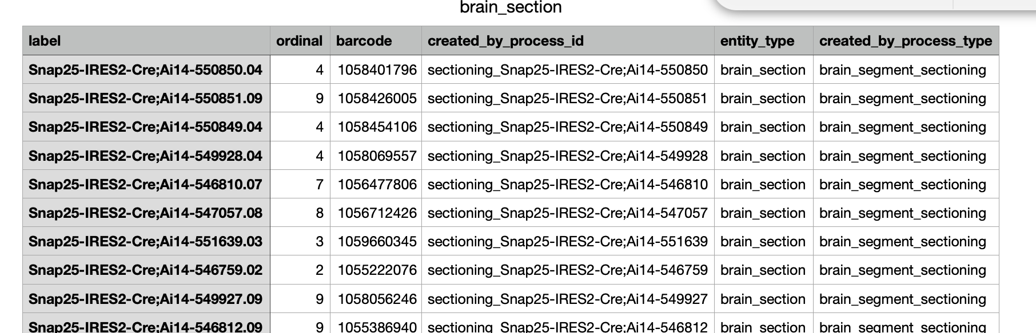
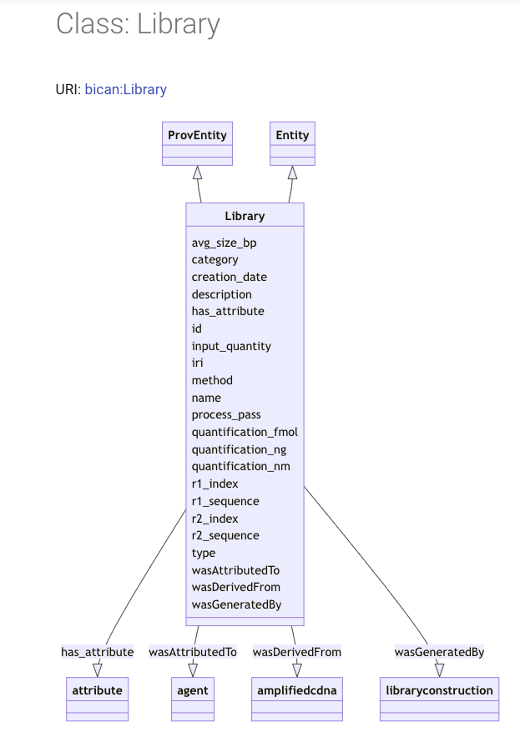
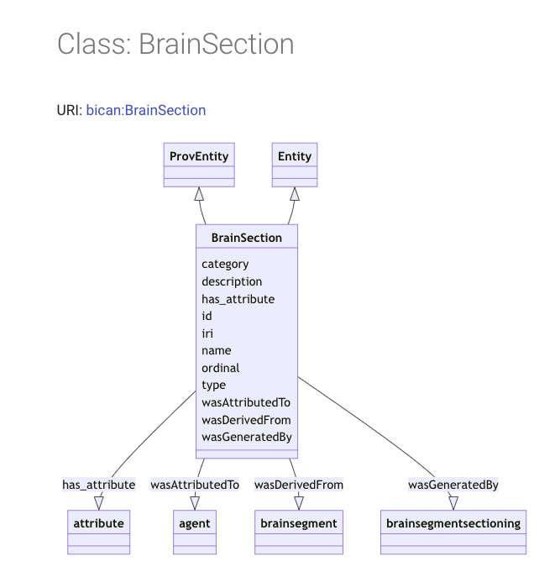
Custom mapping of data to models
/some/isilon/directory
https://github.com/AllenInstitute/abc_kb_ingest/tree/main/notebooks
https://atlaskb.github.io/models/
Notes:
The ABC data corresponds to several of the AtlasKB models such as brain section and library. The data was also mapped to the AtlasKB models using a set of Jupyter notebooks (by Lydia? Dorota? Puja?)

Slide 5
Notes:
As a next step the data integration team looked at whether we could use our ingest pipeline with the AtlasKB LinkML models to achieve a data-driven mapping from scientific data files to the model form.
We had already begun using LinkML in some parts of our pipeline configuration.
The question was whether the models were similar enough in form.

Slide 6
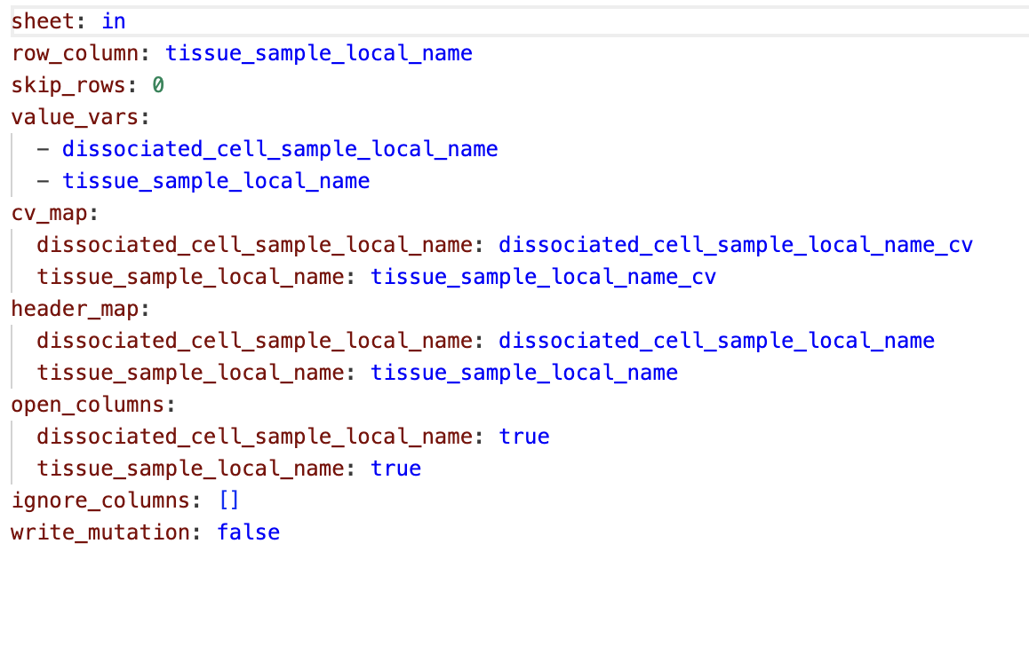
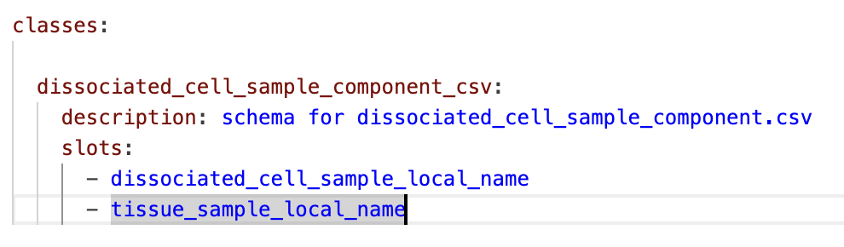
LinkML models as configuration for automated pipelines
generated pipeline configuration
schema model LinkML form
Notes:
The data integration team is in the process of converting our pipeline configuration to use LinkML wherever possible. Rather than reading the models directly we currently do a minimal conversions to create various pipeline formats
This allows us to have an automated processing configuration, but also to use existing LinkML tools where they are available.

Slide 7
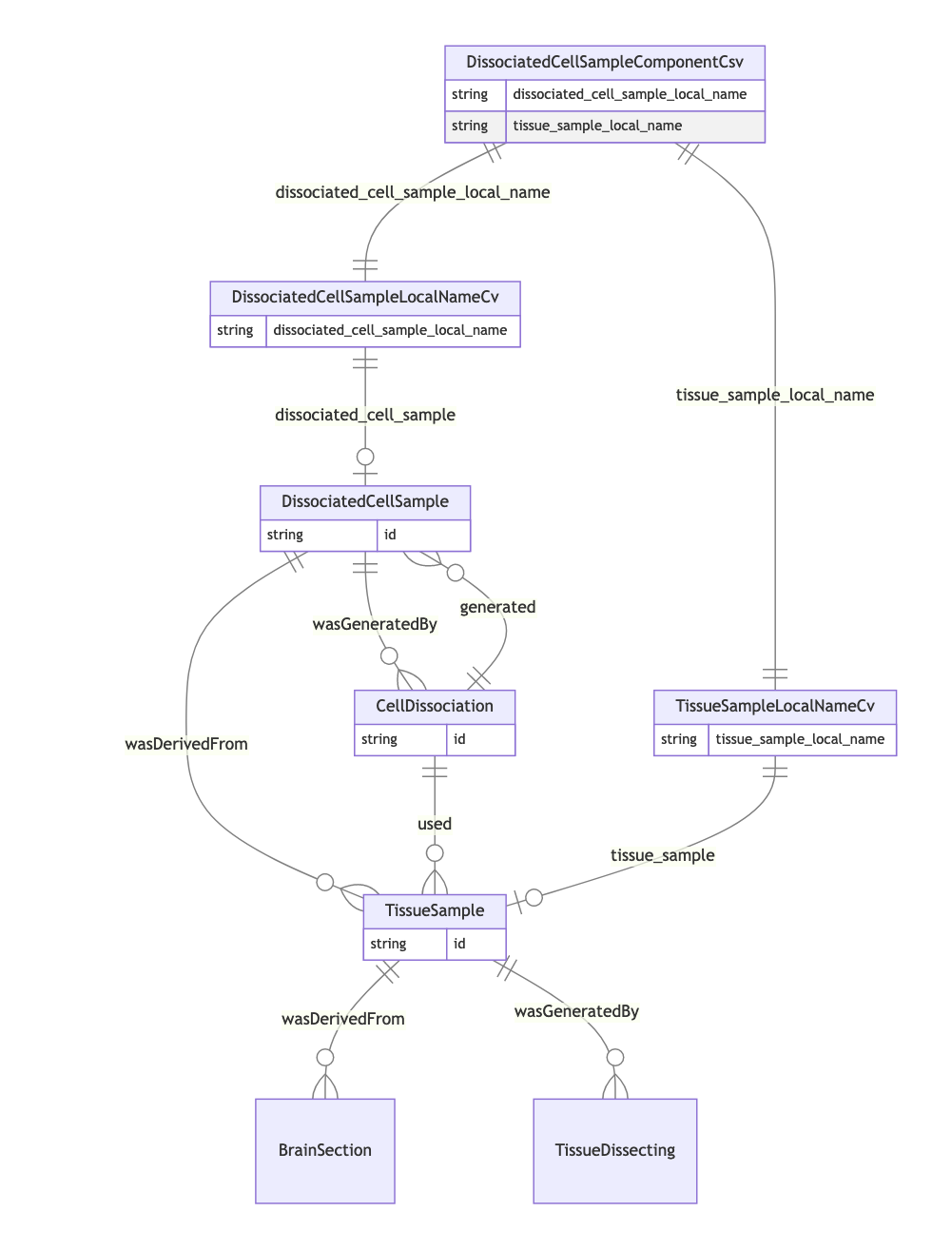
Schema and entity connected by vocabulary
dissociated_cell_sample_component_csv: slots: - dissociated_cell_sample_local_name - tissue_sample_local_name
dissociated cell sample:
slots:
- id
slot_usage:
wasGeneratedBy:
range: cell dissociation
wasDerivedFrom:
range: tissue sample
cell dissociation:
slots:
- id slot_usage: used: range: tissue sample generated: range: dissociated cell sample
tissue sample:
slot_usage:
wasGeneratedBy:
range: tissue dissecting
wasDerivedFrom:
range: brain section
slots:
- id
Data schema models
dissociated_cell_sample_local_name_cv:
slots:
- dissociated_cell_sample_local_name
- dissociated_cell_sample
tissue_sample_local_name_cv:
slots:
- tissue_sample_local_name
- tissue_sample
Vocabulary models
Entity models provided by AtlasKB
Notes:
What we found is two kinds of additional LinkML models are useful for automated processing. Fortunately these are simple to create. The first is a schema model representing the input table. It is essentially a list of the column names.
The second kind of model is the vocabulary. This links the label in the input table to the entity class and ID that are the normalized representation of the graph.
As a result of sharing vocabularies between input tables they end up being connected through the entity models into a complete graph.

Slide 8
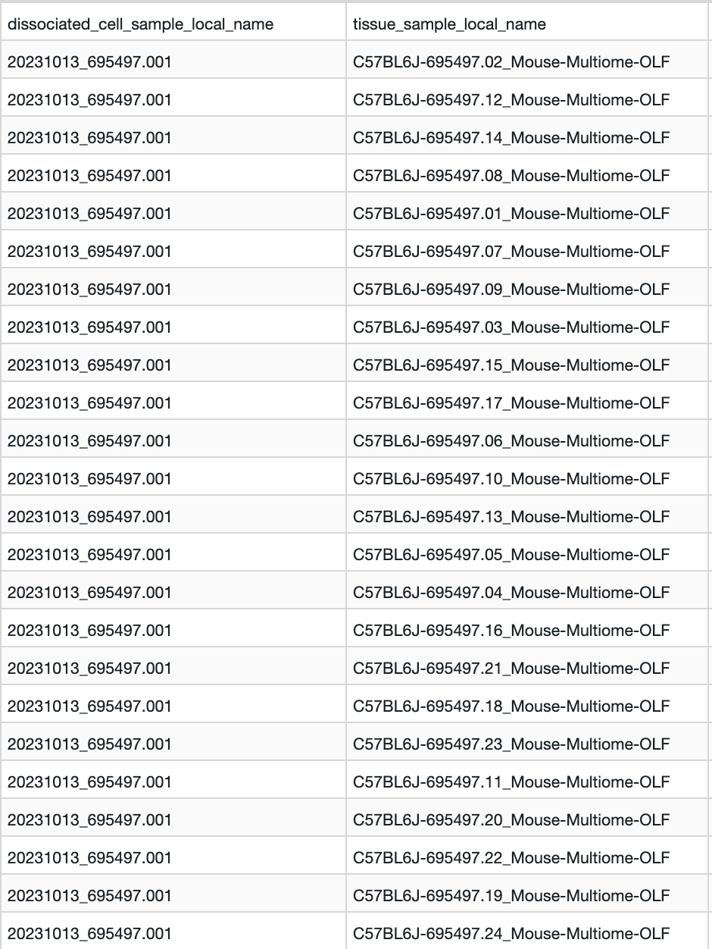
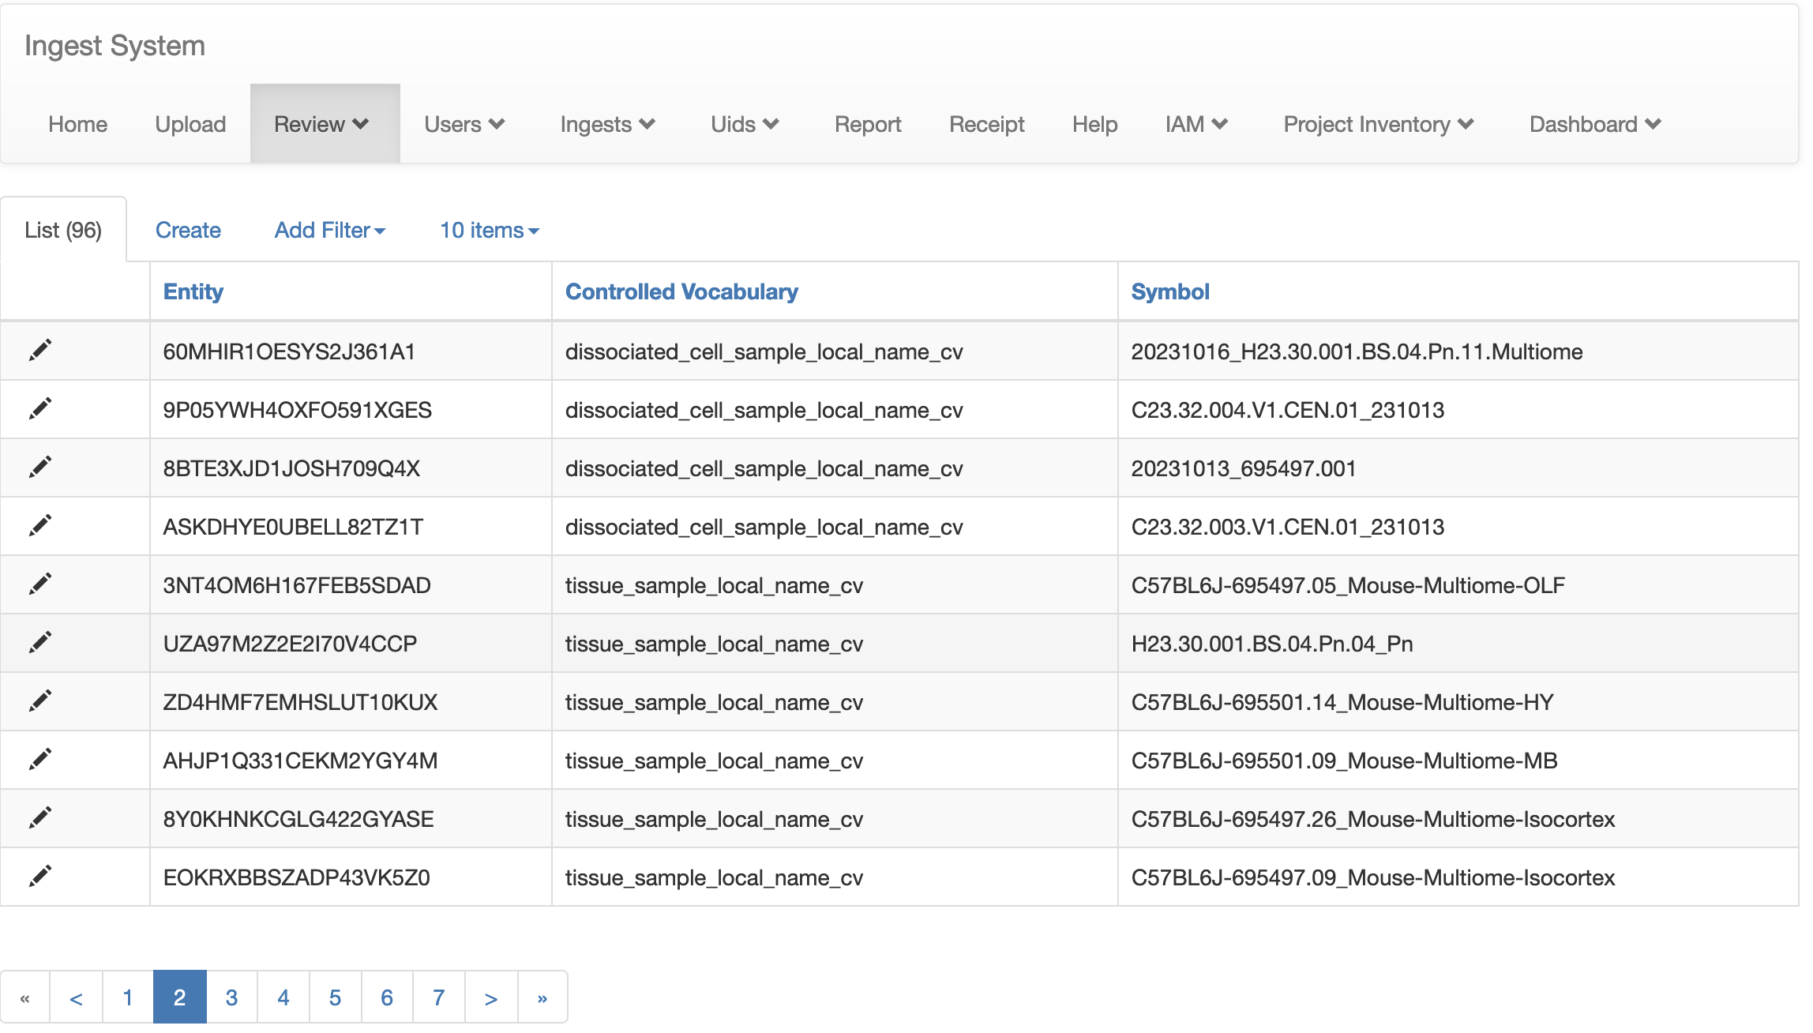
Data Integration Ingest: Web UI and Pipeline
Labels from input are normalized and assigned IDs if needed
Vocabulary review view with UIDs
Notes:
Once a data table is read into the pipeline, all labels are checked against their corresponding vocabulary. If a vocabulary is being seeded an ID can be assigned, or it is now possible to include an ID from an external provider. The IDs are cached in a single data table in S3 partitioned by vocabulary. The web UI provides a simple vocabulary review page.

Slide 9
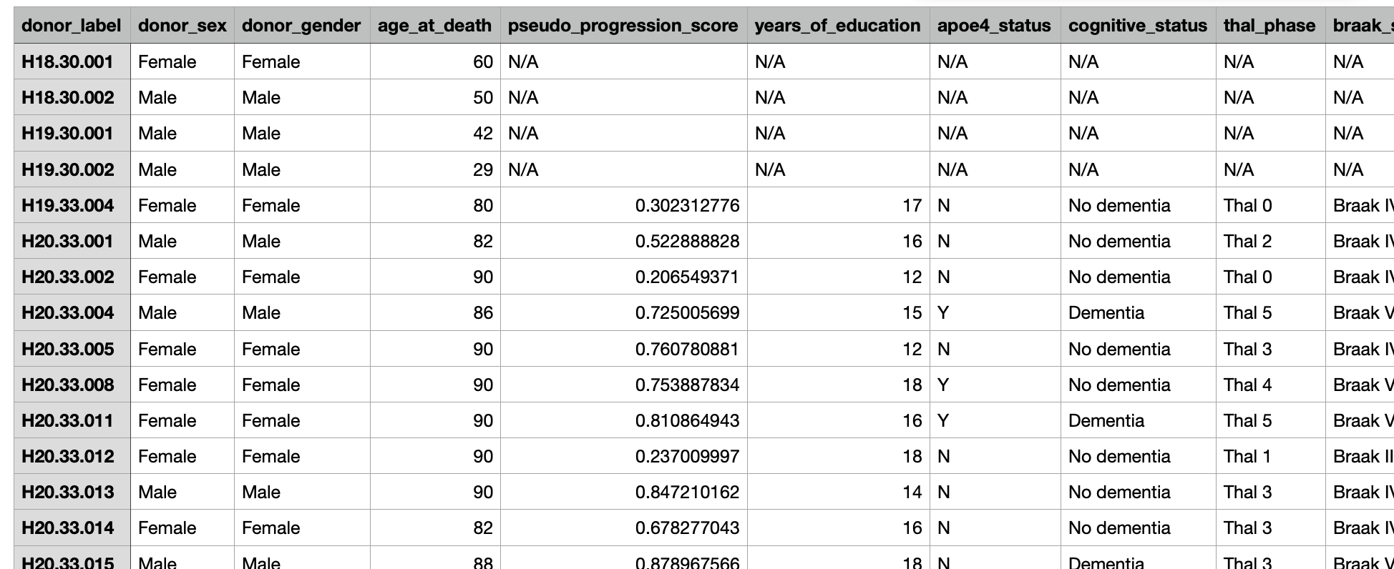
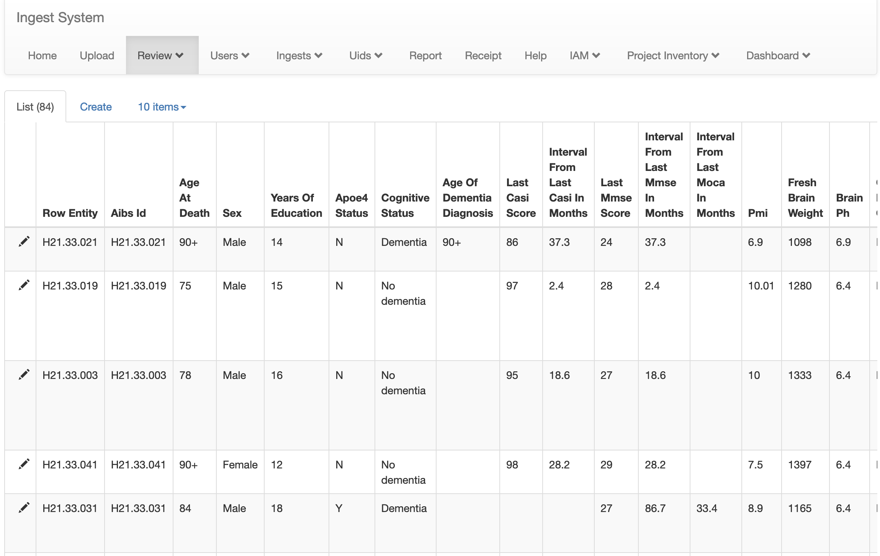
Data Integration Ingest: Review View
Input dataset
Dataset review after vocabulary validation
Notes:
The data integration pipeline also stores the ingested data in an internal format designed to be convertible for use with various external systems.
There is also a simple review page that recapituales the input table. The example shown here is from a recent ingest of Alzheimer's donor data.

Slide 10
DEMO
Loading a data table with LinkML schema and vocabulary configuration
Notes:
Open in Tad: /Users/tpfliss/git/dlm/inputs/atlaskb/dissociated_cell_sample_component.csv
Run local ingest:
cd ~/git/dlm
./config/atlaskb/local_ingest.sh

Slide 11
Notes:
The primary purpose of the ingest system is to load data into the Allen Institute services including the Biological Entity service and the Process Tracking Service. However we have recently started to make the export serialization pluggable to accommodate serialization and export to various services.

Slide 12
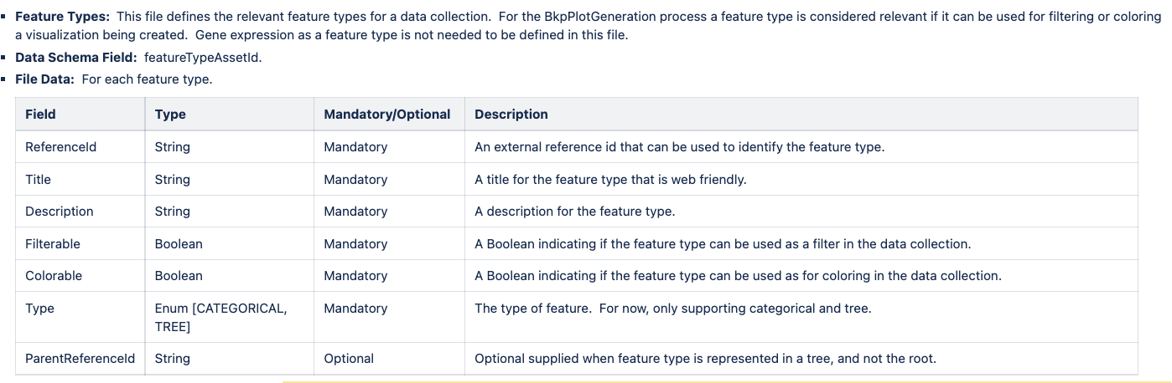
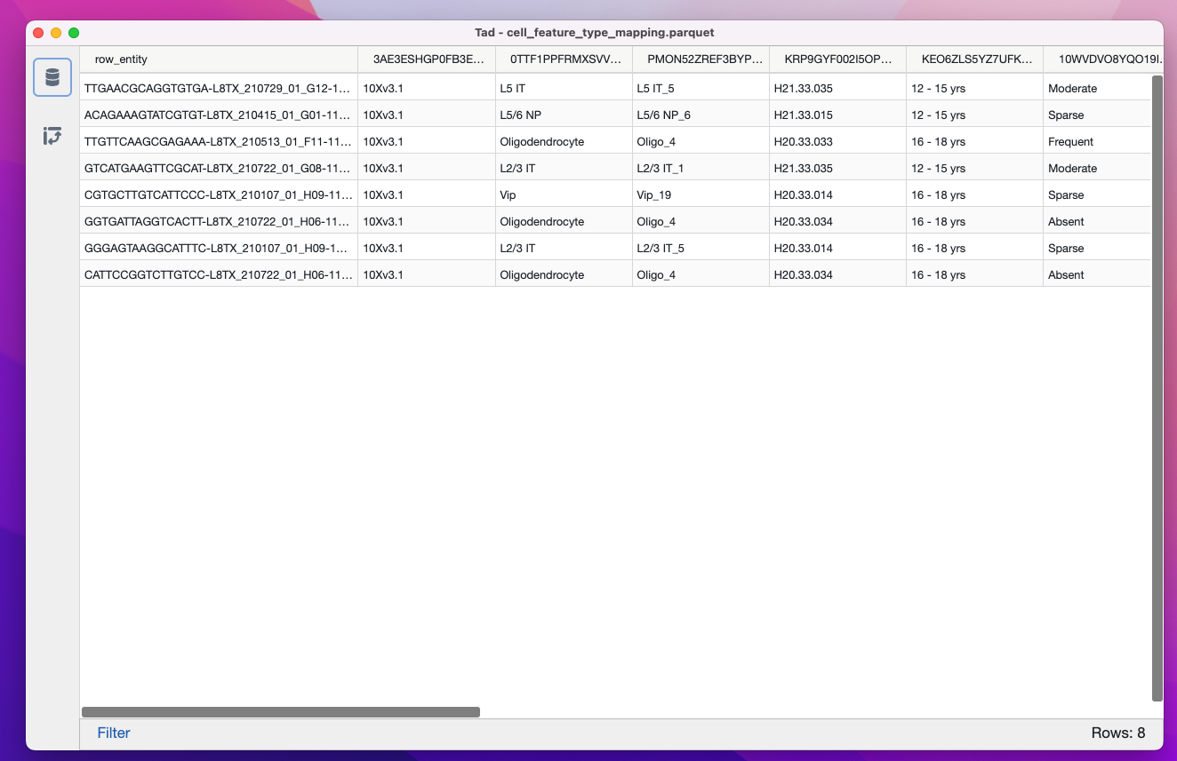
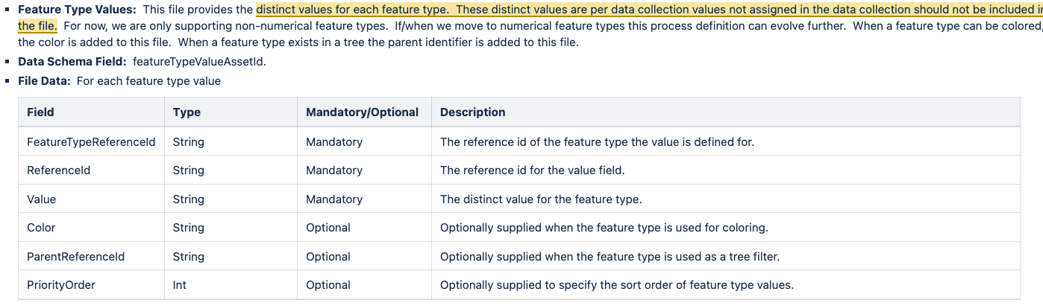
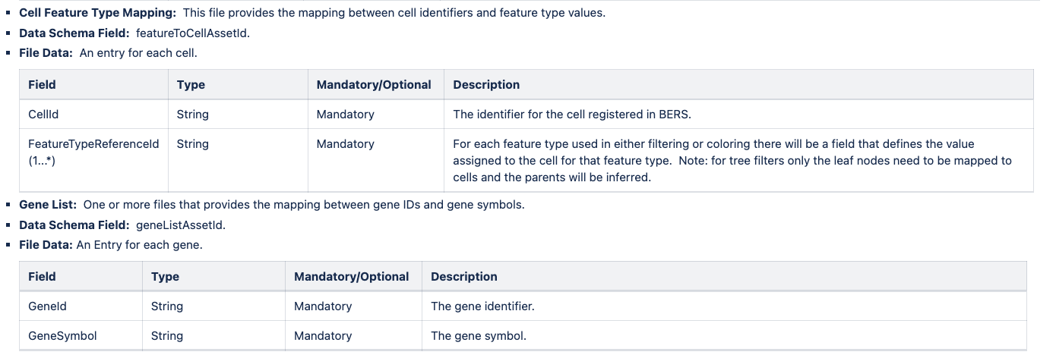
Data Integration Ingest: “pluggable” export
API Contract
Notes:
Our internal data format is essentially the IDs of two entities and the ID of the association between them (variously called a property, a feature type, column). This is basically the input table that has been 'melted' from wide to long format, and as discussed earlier the IDs are found by looking up the values in the vocabulary table.
To a first approximation this is a similar representation to a triple store, so it's not surprising that it is easy to export to graph formats.
It can also be pivoted back to a wide form to export as a table. Or it can be nested with dataframe operations to produce formats such as JSON or GraphQL. Any of these operations are done in lightweight output adaptors implemented as Python modules.

Slide 13
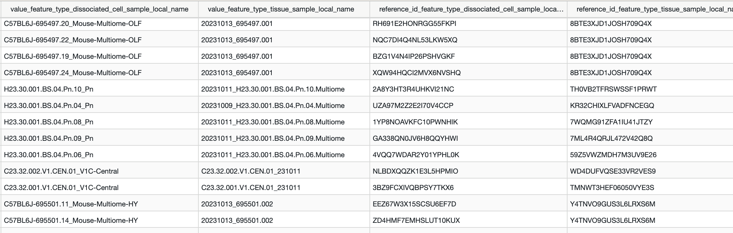
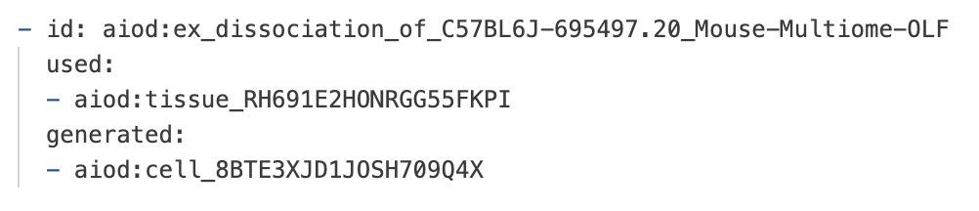
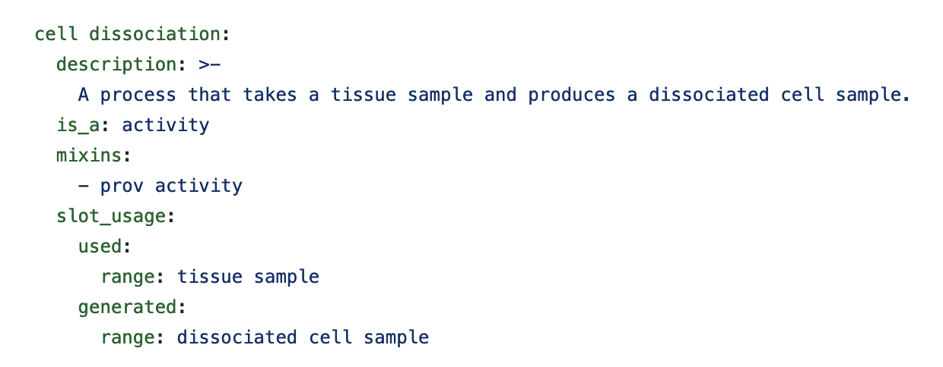
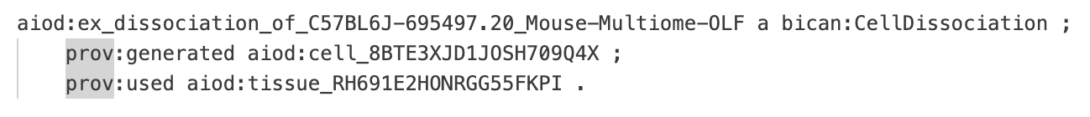
linkml-convert RDF generator
Intermediate YAML or JSON form
data table with associated IDs
RDF/Turtle Fragment
LinkML activity/process model
Notes:
For the purpose of this evaluation we created an output adapter that converted the input files to YAML form. This can then be processed with the LinkML gen-rdf tool with the AtlasKB models to produce RDF/Turtle format. In this way we could confirm that our pipeline was interoperable with AtlasKB models. An interesting thing about this approach is that each CSV provides partial information for more than one entity model. But by configuring which ids and labels to send to the entity model slots we can generate graph fragments that properly match to form a complete entity.

Slide 14
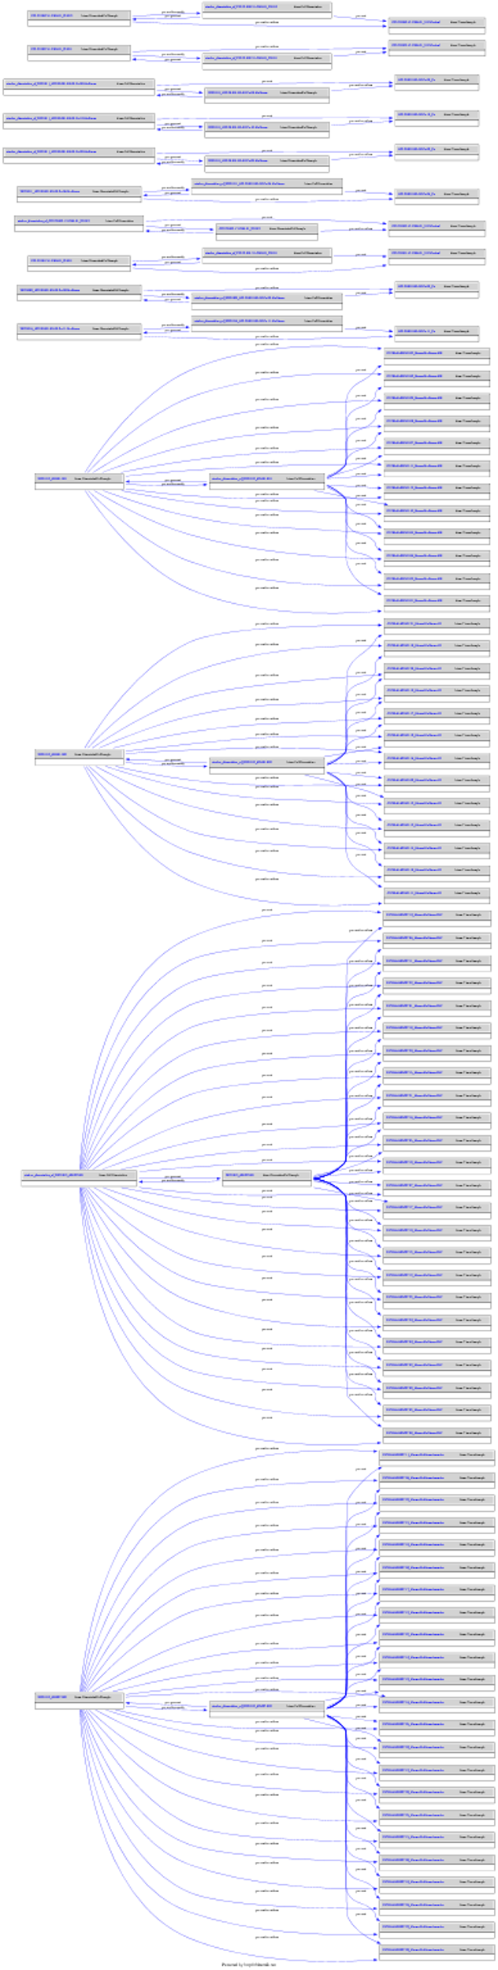
Visualize graph as SVG diagram
non-pooled
aiod:ex_dissociation_of_20231013_695497.001 a bican:CellDissociation ;
prov:generated aiod:cell_8BTE3XJD1JOSH709Q4X ;
prov:used aiod:tissue_RH691E2HONRGG55FKPI .
aiod:tissue_RH691E2HONRGG55FKPI a bican:TissueSample .
aiod:cell_8BTE3XJD1JOSH709Q4X a bican:DissociatedCellSample ;
rdfs:label "20231013_695497.001" ;
prov:wasDerivedFrom aiod:tissue_RH691E2HONRGG55FKPI ;
prov:wasGeneratedBy aiod:ex_dissociation_of_20231013_695497.001 .
pooled tissue
graph fragment derived from a single row of input data
graph fragment from small input data file
Notes:
The RDF output from LinkML linkml-convert for a small data file can be plotted using an online tool. It's easy to see the inverse generated and "was generated by" properties from the PROV ontology like Dorota showed in her slides. The tissue and dissociated cell entities relate to each other both directly and as process inputs and outputs. In the graph for the whole data file it's easy to see that some cells were dissociated from pooled tissue samples and others derived from a single tissue sample. If we repeated this process for the other tables it would extend the chain of process inputs and outputs to recapitulate the purple-box diagram at the instance level.

Slide 15
DEMO
Export Data as RDF using LinkML models and gen-rdf tool
Notes:
Intermediate file is available in s3:
awslocal s3 cp s3://datalocks-eval/review.parquet/part-0.parquet .
Open part-0.parquet in Tad Our internal data format has the information needed to write a YAML file that the LinkML rdf-gen tool can use as input
Run test code to generate RDF (needs to be hooked up to interrmediate file) cd ~/data_locks
pytest -s -k tests/one_file_patterns/test_one_file_patterns.py You can see the YAML and RDF go past

Slide 16
Future work
Inform API handshakes/vocabulary services with schema and vocabulary models
Extend example with various ID providers (BERS / NHASH / Local IDs)
Extend configuration to more data tables
Integrate back into ingest api UI for more self service and automation
Standardize upstream data/controlled vocabularies
Include ontology integration (ex: seed CVs from ontologies)
Harmonize BICAN anndata standards
Further reading:
https://github.com/brain-bican/Metadata-Huddle-2023/tree/di_demo/data_integration_demo

Slide 17
THANK YOU
For their essential contributions, we would like to thank:
Satra Ghosh, Dorota Jarecka, Puja Trivedi and the Knowledge Base team;
Lydia Ng and Kimberly Smith at AIBS;
the Data Integration Team at AIBS
Funding:
Research reported in this publication was supported by the National Institute Of Mental Health of the National Institutes of Health under Award Numbers U24MH130918-01, U24MH130919-02, R24MH114788 and U24MH130968-02. The content is solely the responsibility of the authors and does not necessarily represent the official views of the National Institutes of Health. We wish to thank the Allen Institute founder, Paul G. Allen, for his vision, encouragement, and support.
brain-map.org

